Slide 1
AGARPATHI + HANGYO
Designer vs Automated

Slide 2
What was fixed in this round
Found by comparing every board with the designer's own picture; each fix was checked on the real boards in CorelDRAW
Hangyo
- Tamil name ran past the white panel on the 10x3 boards - names are now held inside the panel (two lines, like hers)
- Names on the wide boards (16 - 26 ft) were 30-40 % smaller than hers - the panel now takes the width of the designer's board of that size and the names fill it
- English names are set in capitals, as on every designer board
- Shop names that wrap now break where she breaks them (Asian / Juice Bar, not Asian Juice / Bar)
- Tamil text on the 8x3 GSB boards was stretched to twice its width - fixed (the line was resized twice)
- The second logo is now drawn on the 10x4 GSB and 8x3 GSB boards, where she repeats it (the library now recognises a repeated logo even when she added or dropped a shape in the copy)
Agarpathi
- 13x2, 10x3 and 5x5 ft boards: the English and Tamil names were printed on top of each other - each line now keeps its own place
- 13x2 ft: the Sugandha Swarna logo is back in the right place and size (similarity 0.89 -> 0.94)
- Library rebuilt from all 62 designer files - 22 boards gained their English name box
Both brands
- Shop-name line breaks, name sizes and panel widths are now data in the brand library, not code - a new brand needs no code change
- All 957 backend tests and 269 frontend tests pass (backend baseline 939 + new tests for each fix)

Slide 3
What is still different from the designer
Honest list - none of these crash or break a board, they are look-and-feel differences
Cannot be done from the master
- Agarpathi 35x4 ft: the designer added a maroon centre panel and a second picture set that the master does not contain
- Hangyo 3x6 ft portrait boards still use the plain layout (the 4 X 8 master matches no designer element)
Approximations
- Hangyo 20x4 ft PERUMAL STORE: her panel on that board is narrower and the name is on two lines, ours uses the 20x4 panel width of the nearest board
- Jairam maligai 20x4: she sets the Tamil on two big lines, we keep one line (the rule follows the nearest board)
- English names on the 3 ft high boards sit close to the ice-cream pictures, as on her boards, but the exact line break can differ
- Names the designer retyped (for example NN POOJA STORE for NN NATTU MARUNDHU KADAI) come from the sheet, so the wording follows the sheet
- The similarity score compares whole pictures - it hardly moves when only the name size changes. Judge by the slides.
Not tested yet
- Sizes the designer never made (a new size is a guess from the nearest board)
- Dalmia and Agni through the example library

Slide 4
Hangyo - at a glance
22 boards: boards the designers made, regenerated by the app (designer Tamil names from her files)
6/22
15/22
1/22
0/22
Very close
Close
Different
Wrong proportions
pixel similarity 95 % or more
88-95 % similar
under 88 % similar - layout or text differs
aspect ratio differs from the designer's by more than 5 %
How it is measured
Each automated picture is paired with the designer's JPEG of the same S.No, size and shop. Similarity = 1 - mean grey-level difference of both pictures at the same reduced size (average 0.93). It rates the whole picture, so a different shop name or a small shift barely moves it - look at the slides.
Proportions are compared from the pixel size of each picture.

Slide 5


S.No 1
Asian Juice bar
16 X 3 Feet - Frontlit
CLOSE (89 %)
DESIGNER
AUTOMATED

Slide 6


S.No 3
Shenbagam Enterprises ( Jothi maligai)
4 X 8 Feet - Nonlit
VERY CLOSE (98 %)
DESIGNER
AUTOMATED

Slide 7


S.No 4
Lakshmi Store
10 X 3 Feet - Nonlit
CLOSE (91 %)
DESIGNER
AUTOMATED

Slide 8


S.No 8
Sri Ganesha Kitchen
26 X 3 Feet - Frontlit
CLOSE (90 %)
DESIGNER
AUTOMATED

Slide 9


S.No 10
Jeeva hotel
20 X 4 Feet - Frontlit
CLOSE (93 %)
DESIGNER
AUTOMATED

Slide 10


S.No 14
New Sri happy Iyengar bakery
8 X 4 Feet - GSB
VERY CLOSE (96 %)
DESIGNER
AUTOMATED

Slide 11
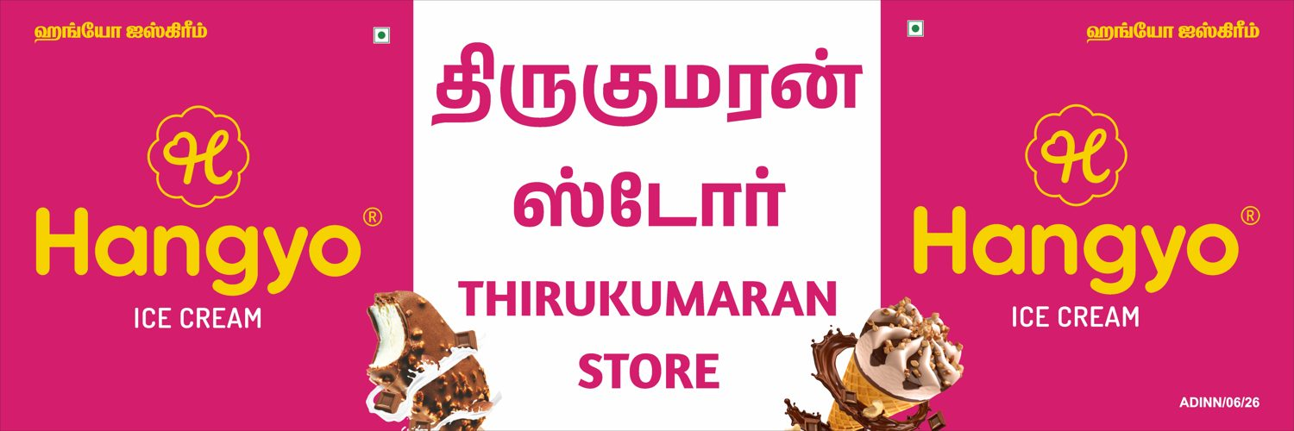
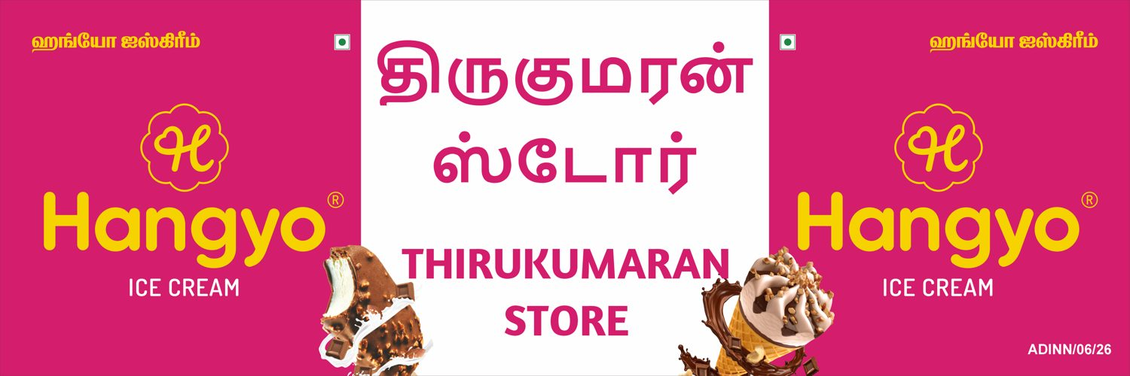
S.No 17
Thirukumaran store
12 X 4 Feet - Nonlit
CLOSE (93 %)
DESIGNER
AUTOMATED

Slide 12
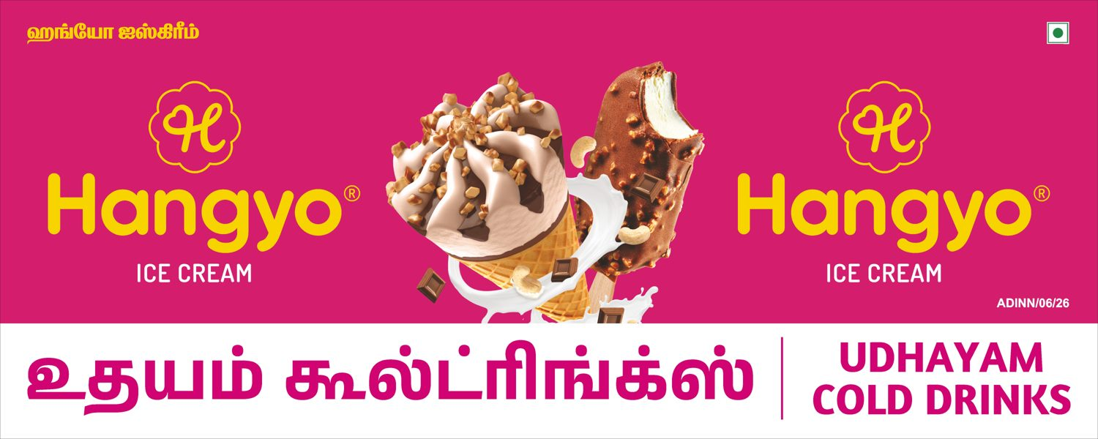
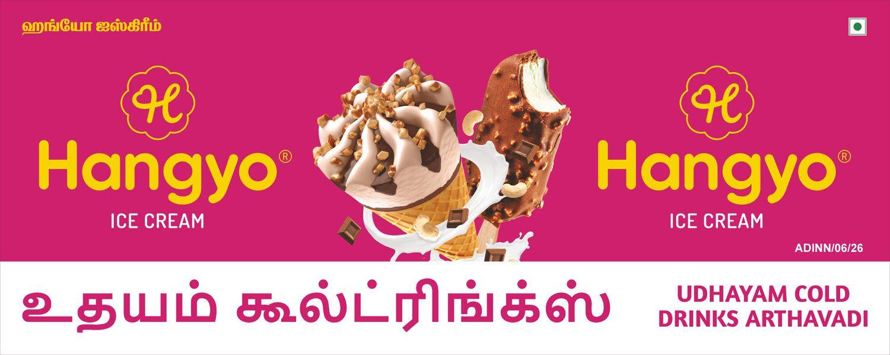
S.No 18
Udhayam cold drinks arthavadi
10 X 4 Feet - GSB
VERY CLOSE (97 %)
DESIGNER
AUTOMATED

Slide 13


S.No 19
Sivani Maligai
10 X 3 Feet - GSB
CLOSE (92 %)
DESIGNER
AUTOMATED

Slide 14


S.No 20
Sri thanga Vilas soda factory
8 X 3 Feet - GSB
VERY CLOSE (97 %)
DESIGNER
AUTOMATED

Slide 15


S.No 21
Paramasivam store
8 X 3 Feet - GSB
VERY CLOSE (97 %)
DESIGNER
AUTOMATED

Slide 16


S.No 22
Bengaluru bakery
20 X 3 Feet - Frontlit
CLOSE (89 %)
DESIGNER
AUTOMATED

Slide 17


S.No 23
Guru tea stall
10 X 3 Feet - Frontlit
CLOSE (93 %)
DESIGNER
AUTOMATED

Slide 18


S.No 24
PERUMAL STORE
20 X 4 Feet - Frontlit
DIFFERENT (86 %)
DESIGNER
AUTOMATED

Slide 19


S.No 25
Karthikeyan store
10 X 3 Feet - GSB
CLOSE (95 %)
DESIGNER
AUTOMATED

Slide 20


S.No 25
Karthikeyan store
20 X 3 Feet - Frontlit
CLOSE (89 %)
DESIGNER
AUTOMATED

Slide 21


S.No 26
Om guru sweets & bakery
20 X 3 Feet - GSB
CLOSE (90 %)
DESIGNER
AUTOMATED

Slide 22


S.No 27
Jairam maligai
20 X 4 Feet - Nonlit
CLOSE (88 %)
DESIGNER
AUTOMATED

Slide 23


S.No 28
Sekar store
10 X 3 Feet - Nonlit
CLOSE (94 %)
DESIGNER
AUTOMATED

Slide 24


S.No 29
Hotel dhanalakshmi Vilas
15 X 3 Feet - GSB
CLOSE (91 %)
DESIGNER
AUTOMATED

Slide 25


S.No 30
Arulmoli maligai & bakery
10 X 3 Feet - Frotlit
VERY CLOSE (96 %)
DESIGNER
AUTOMATED

Slide 26


S.No 31
Kanish Cool Drink's
10 X 3 Feet - GSB
CLOSE (94 %)
DESIGNER
AUTOMATED

Slide 27
Agarpathi - at a glance
12 boards: boards the designers made, regenerated by the app (designer Tamil names from her files)
10/12
1/12
1/12
0/12
Very close
Close
Different
Wrong proportions
pixel similarity 95 % or more
88-95 % similar
under 88 % similar - layout or text differs
aspect ratio differs from the designer's by more than 5 %
How it is measured
Each automated picture is paired with the designer's JPEG of the same S.No, size and shop. Similarity = 1 - mean grey-level difference of both pictures at the same reduced size (average 0.96). It rates the whole picture, so a different shop name or a small shift barely moves it - look at the slides.
Proportions are compared from the pixel size of each picture.

Slide 28
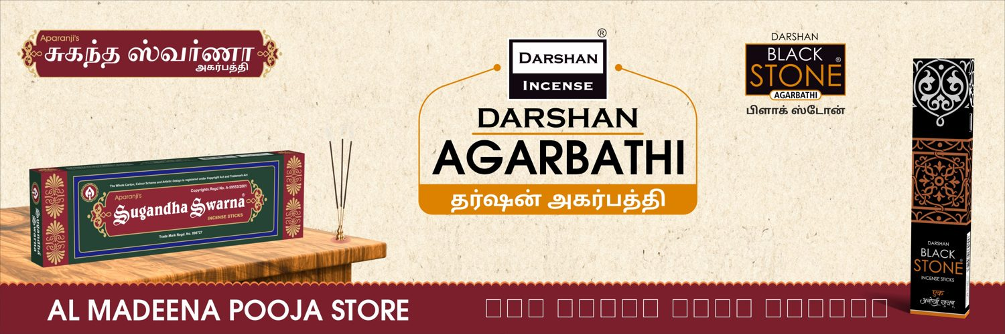

S.No 16
AL MADEENA POOJA STORE
12 X 4 Feet - Nonlit
VERY CLOSE (98 %)
DESIGNER
AUTOMATED

Slide 29
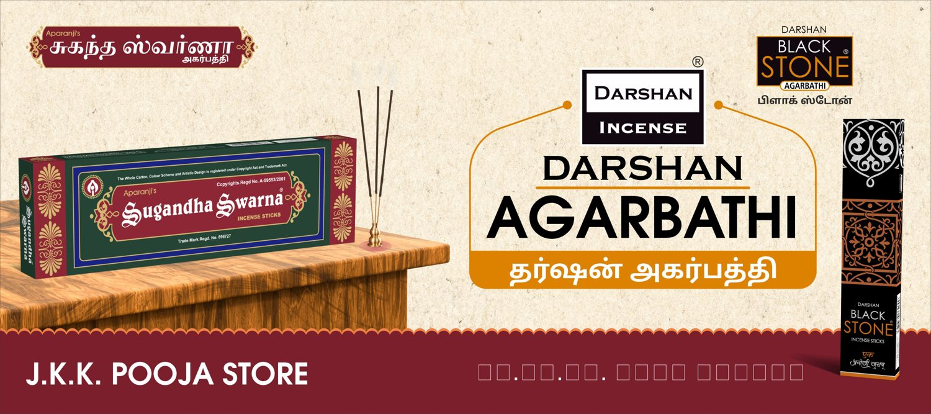
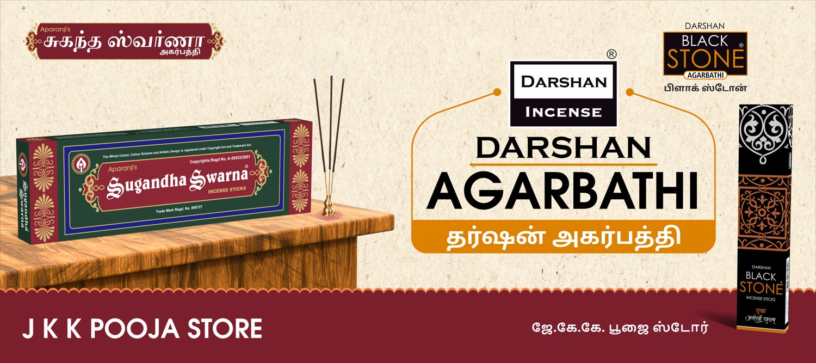
S.No 17
J K K POOJA STORE
9 X 4 Feet - Nonlit
VERY CLOSE (98 %)
DESIGNER
AUTOMATED

Slide 30
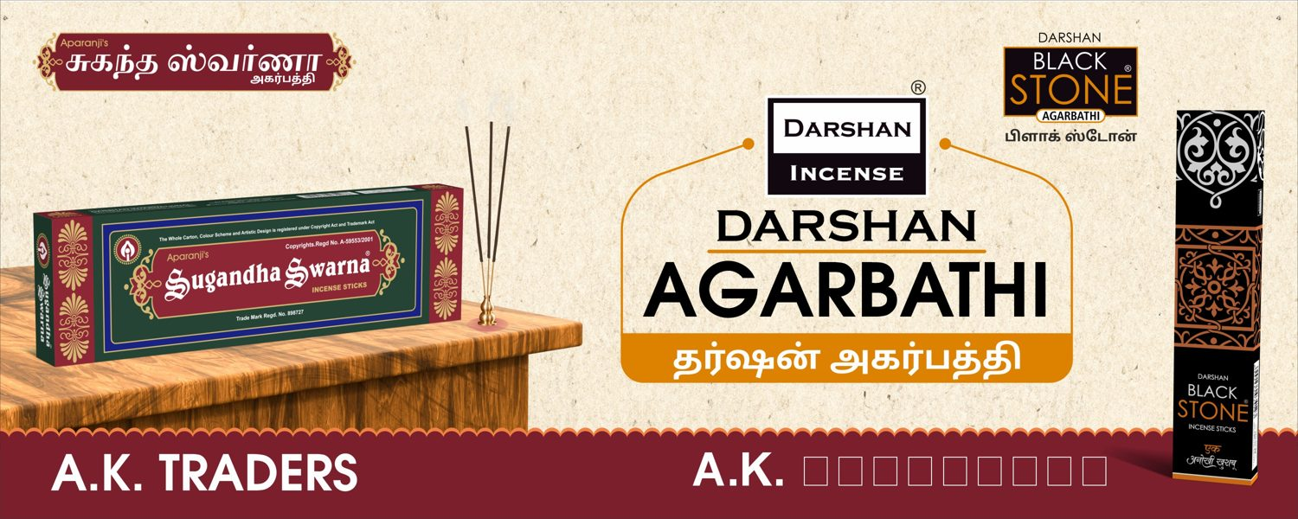
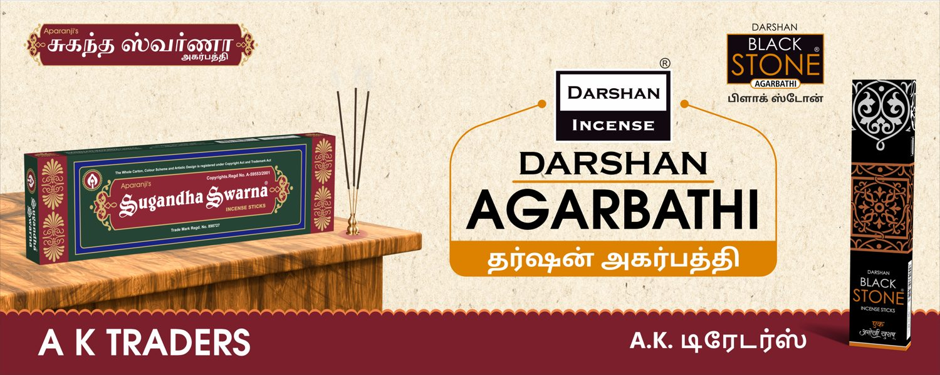
S.No 18
A K TRADERS
10 X 4 Feet - Nonlit
VERY CLOSE (99 %)
DESIGNER
AUTOMATED

Slide 31
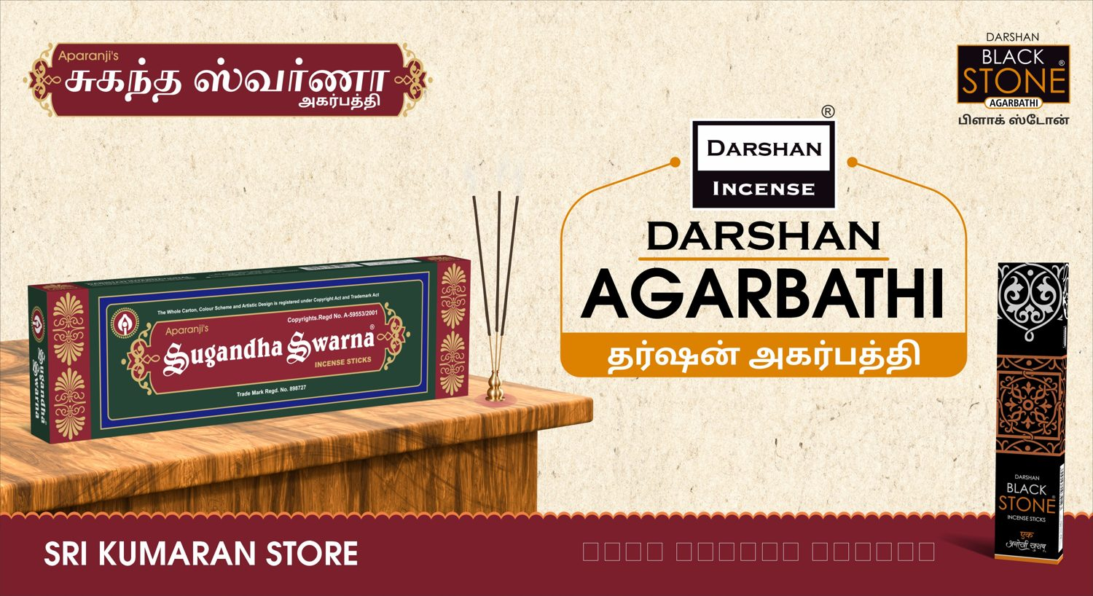
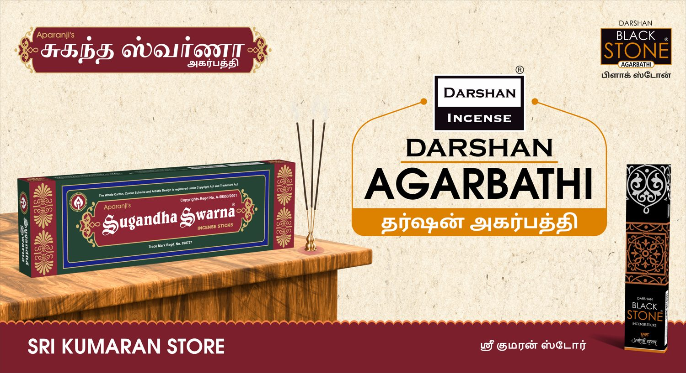
S.No 21
SRI KUMARAN STORE
11 X 6 Feet - Nonlit
VERY CLOSE (99 %)
DESIGNER
AUTOMATED

Slide 32
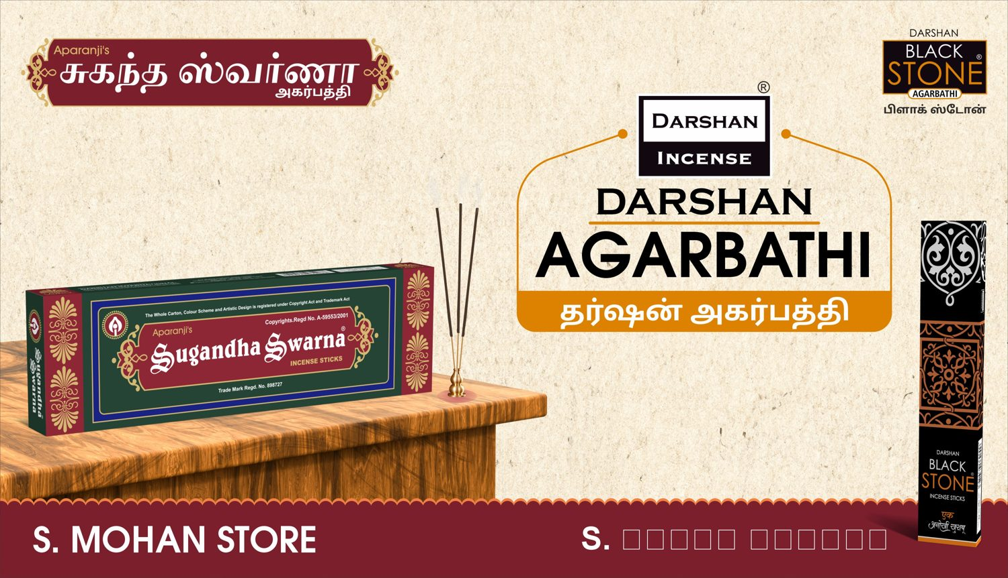

S.No 22
S. MOHAN STORE
94 X 54 Inch - Nonlit
VERY CLOSE (99 %)
DESIGNER
AUTOMATED

Slide 33
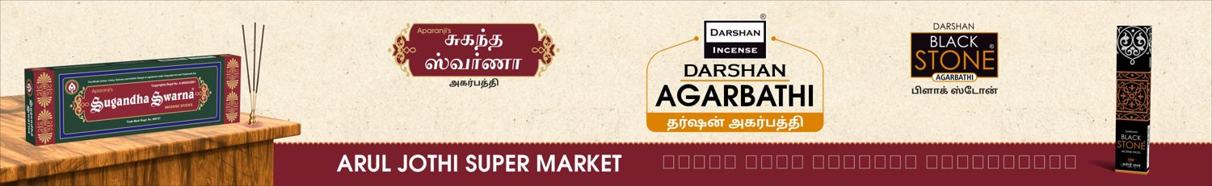
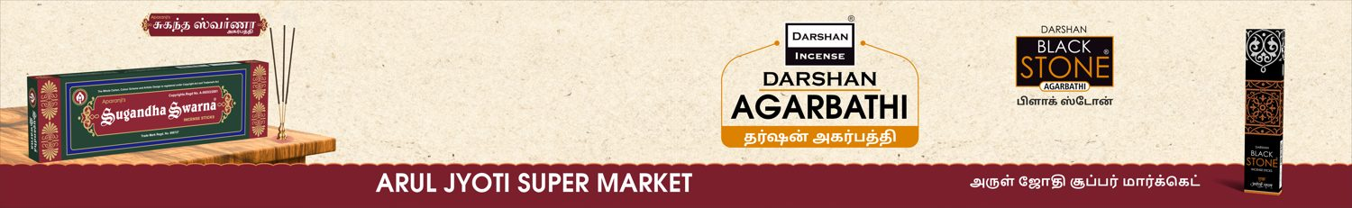
S.No 23
ARUL JYOTI SUPER MARKET
13 X 2 Feet - Nonlit
CLOSE (94 %)
DESIGNER
AUTOMATED

Slide 34
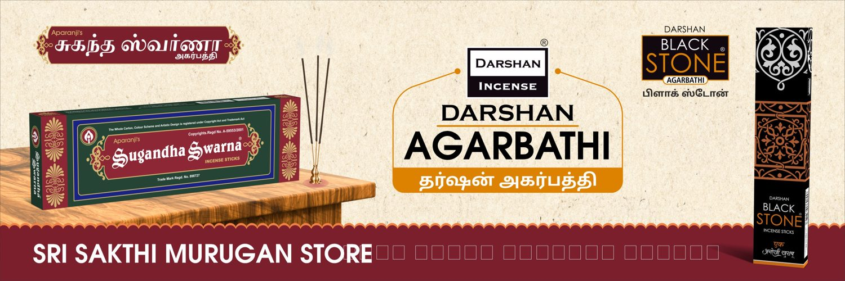
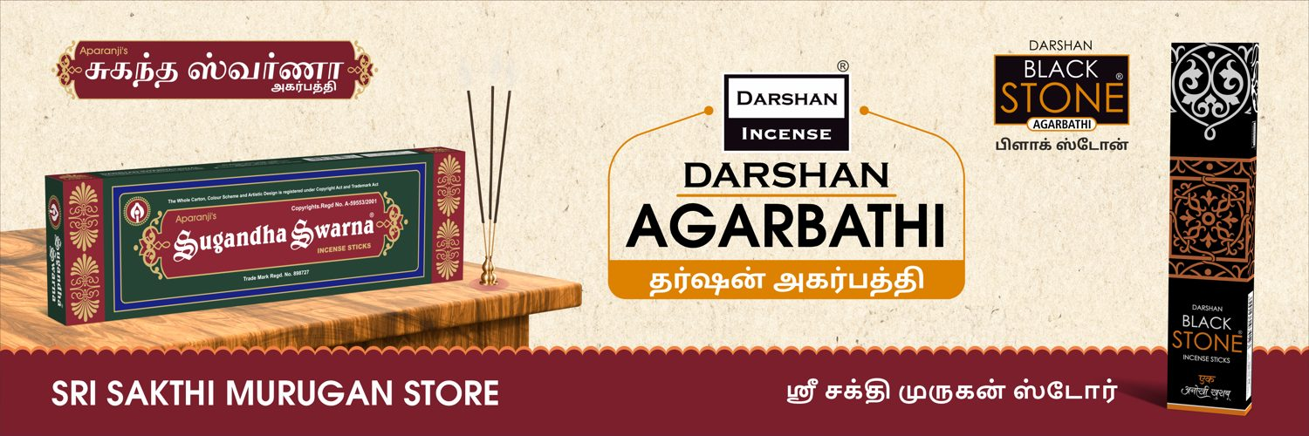
S.No 24
SRI SAKTHI MURUGAN STORE
9 X 3 Feet - Nonlit
VERY CLOSE (98 %)
DESIGNER
AUTOMATED

Slide 35
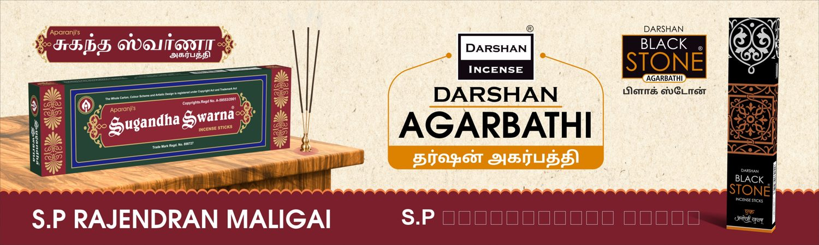
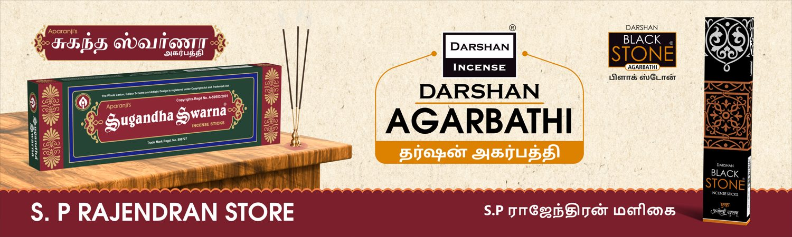
S.No 25
S. P RAJENDRAN STORE
10 X 3 Feet - Nonlit
VERY CLOSE (96 %)
DESIGNER
AUTOMATED

Slide 36
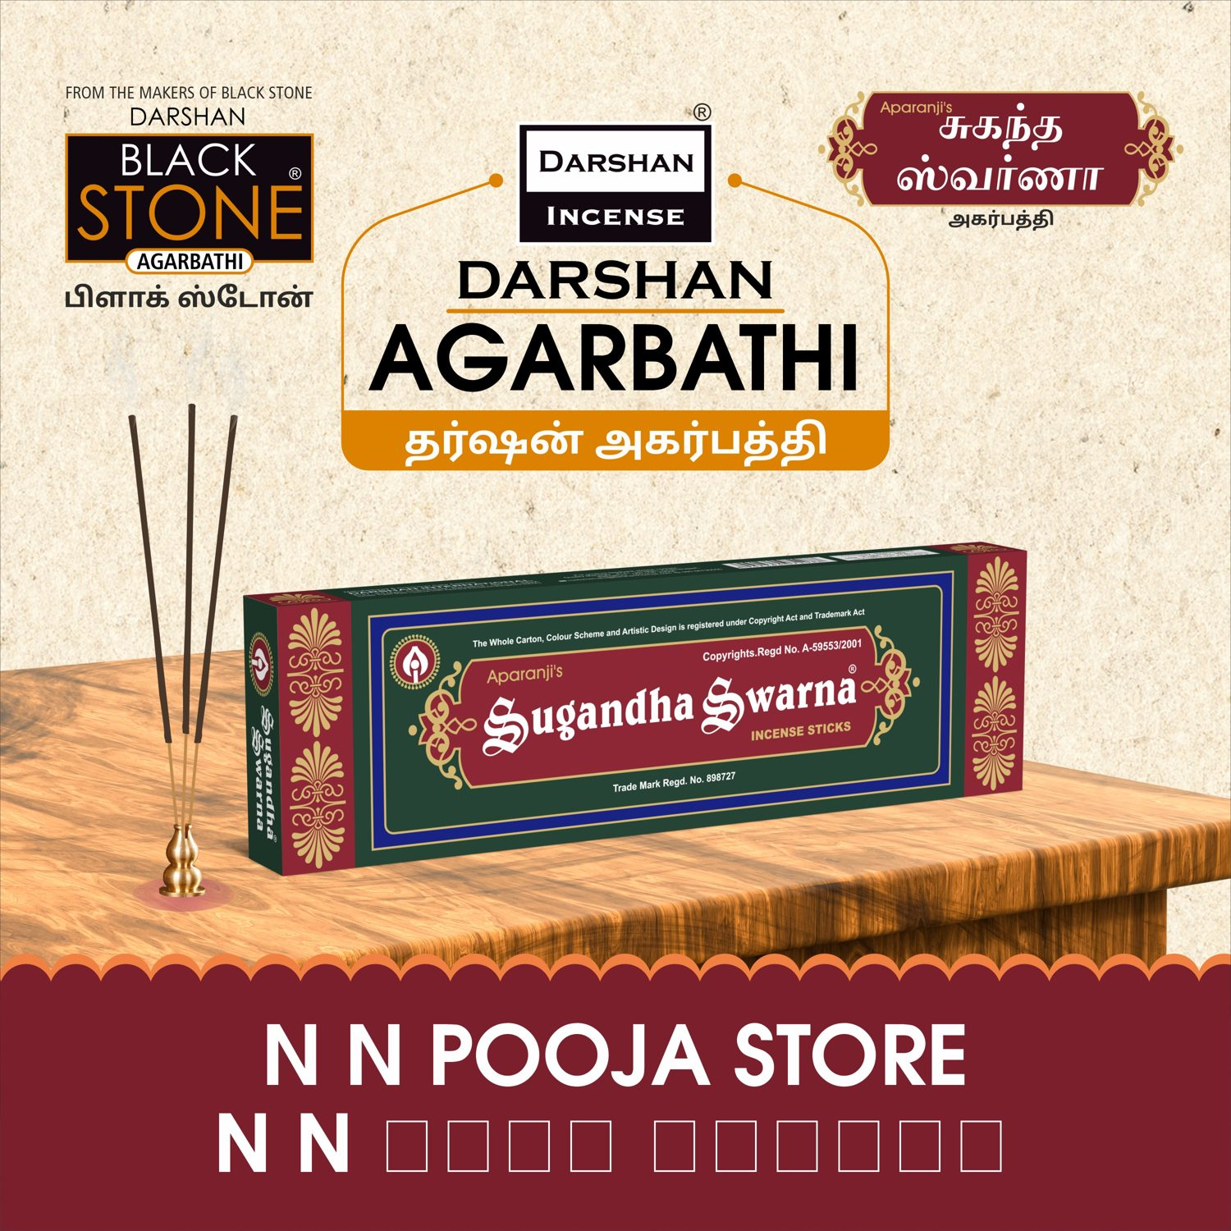

S.No 26
N N NATTU MARUNDHU KADAI
5 X 5 Feet - Nonlit
VERY CLOSE (96 %)
DESIGNER
AUTOMATED

Slide 37
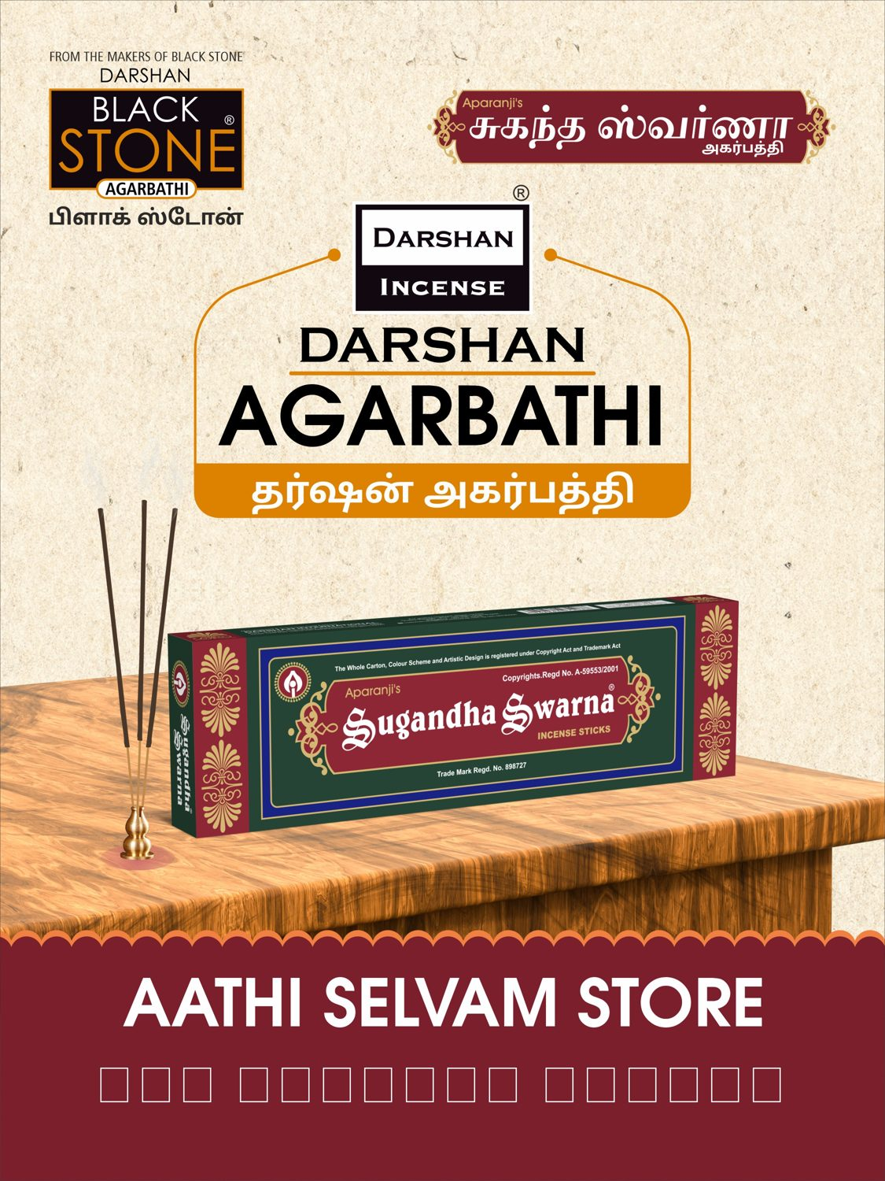
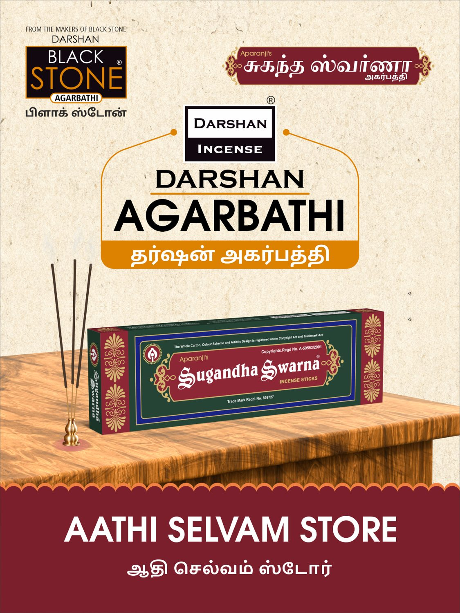
S.No 27
AATHI SELVAM STORE
3 X 4 Feet - Nonlit
VERY CLOSE (98 %)
DESIGNER
AUTOMATED

Slide 38
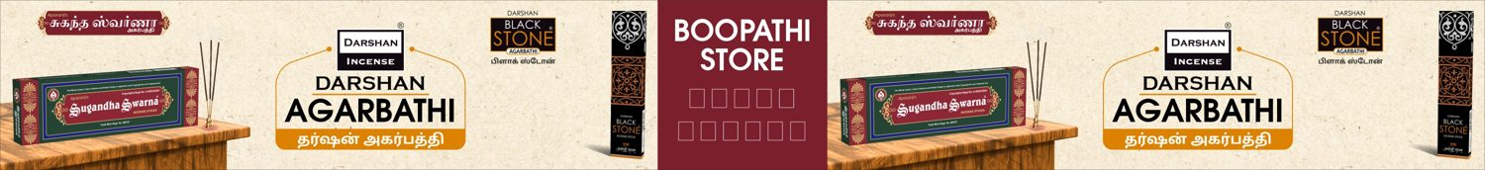
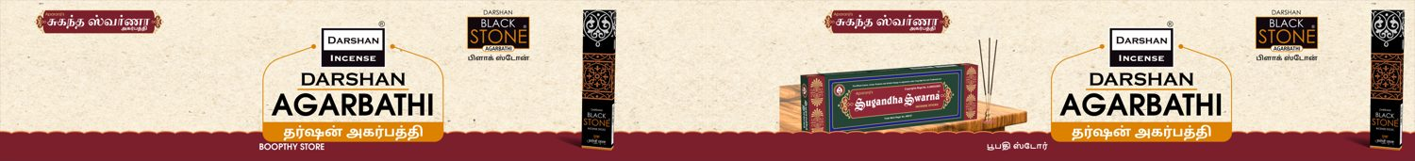
S.No 31
BOOPTHY STORE
35 X 4 Feet - Nonlit
DIFFERENT (83 %)
DESIGNER
AUTOMATED

Slide 39
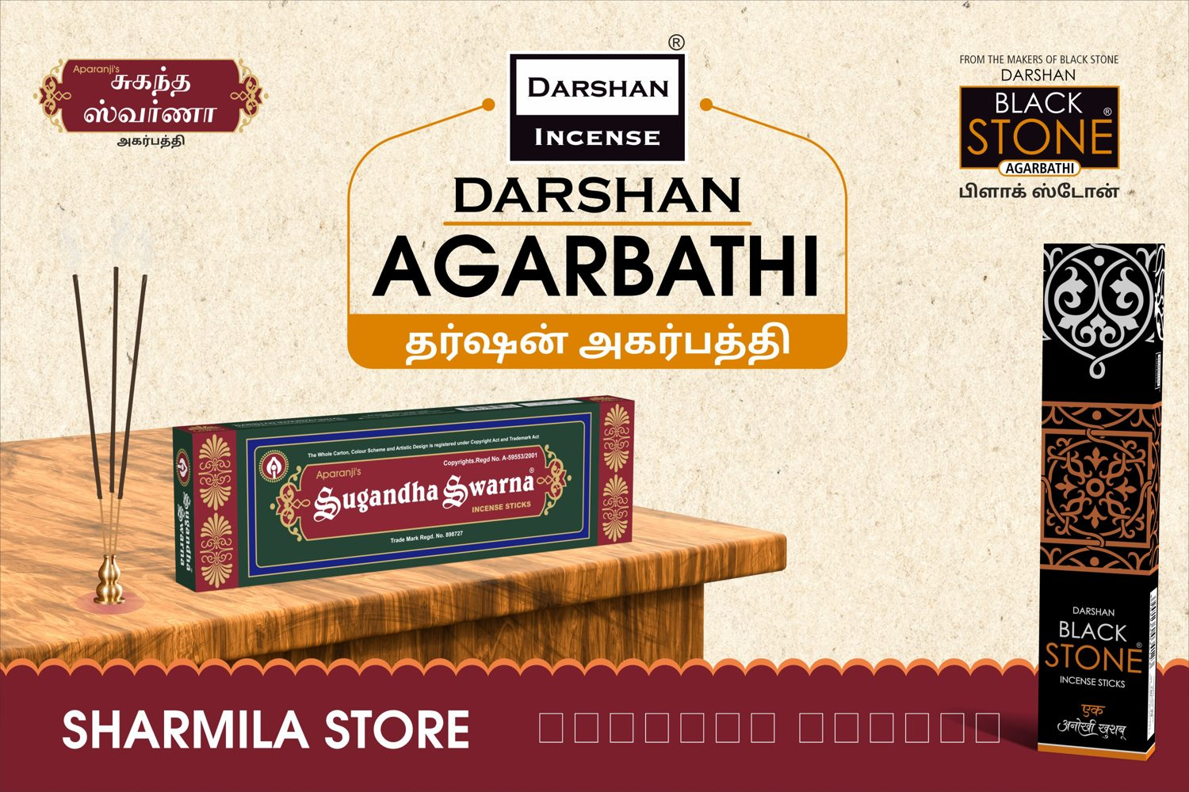
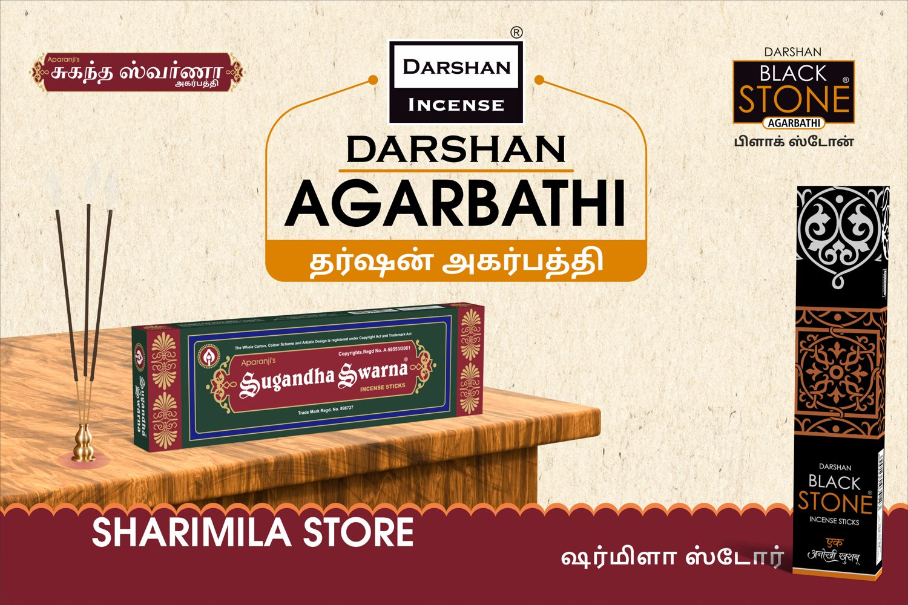
S.No 32
SHARIMILA STORE
6 X 4 Feet - Nonlit
VERY CLOSE (96 %)
DESIGNER
AUTOMATED

